Slide 1
Improving Model Transparency: Transferability and SHAP Analysis for Deep Neural Network Debugging
CSCI 4960
Rebecca Tsekanovskiy

Slide 2
What did I do?
Created a model and see how SHAP could identify how the model was working
Used Kaggle datasets
Identify limitations and errors

Slide 3
What did I do?
Used a pretrained model
Google Colab
Hardware Acceleration: L4 Graphics Processing Unit
Tracked 1st epoch loss, 1st epoch accuracy, last epoch loss, last epoch accuracy
Different optimizers (Adam, SGD.. etc) Different pretrained models (VGG16,VGG19, InceptionV3..etc)

Slide 4
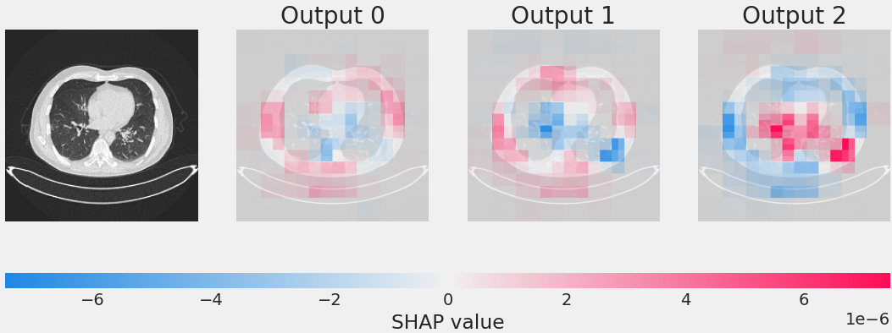
Using SHAP to debug
0= benign; 1= malignant; 2= normal
Benign Lung Cancer Scan
Notes:
Not generalizing information correctly
Not a good data set ( to small, not being processed correctly – imbalanced data )
To simple or to complex of a model ( not enough or to many layers being placed in the model)
- can help go back and change the model architecture – does that work? ; go back and see if your processing correctly? Does that work?
High SHAP values for unexpected features – like outside of the cancer scan. Why??

Slide 5
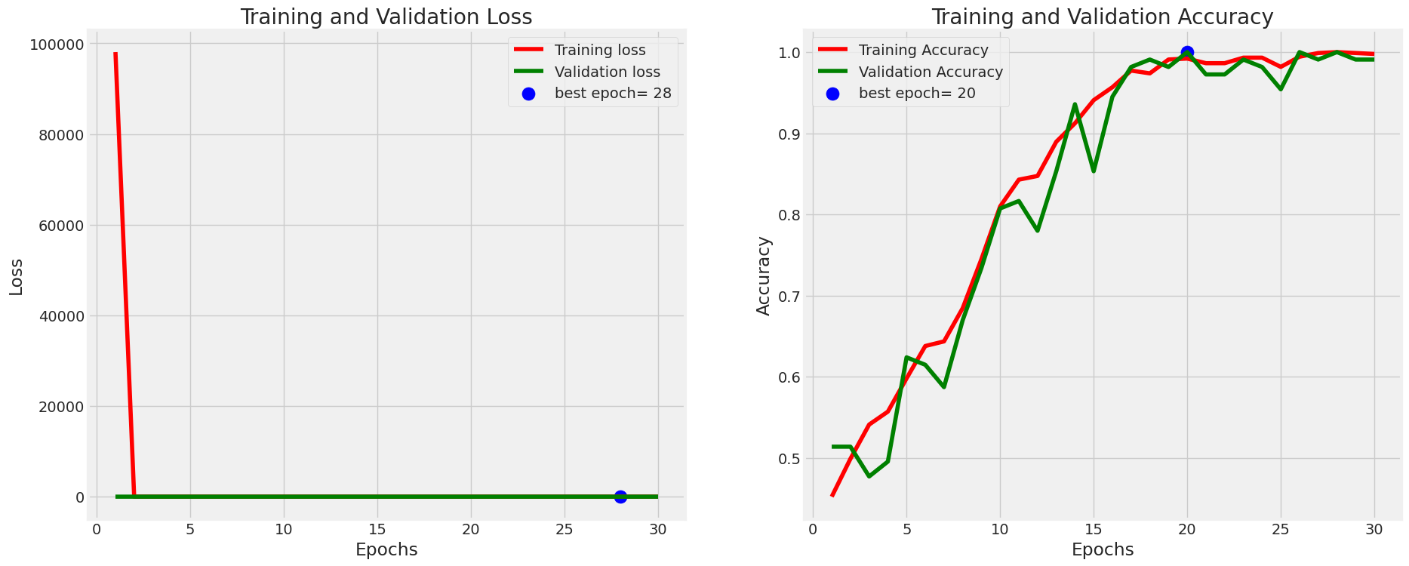
EPOCHS vs Training and Validation Loss/Accuracy
Training loss= how well the model is doing on data it learned
Validation loss= how well the model is doing on data it has not seen
Notes:
Besides shap generalizing information wrong – we can see training loss is a little under 100,000

Slide 6
Now what?
Increased the dataset size
Increased model complexity – more layers, reduced learning rate, early stopping
Used a pre trained model (InceptionV3)
Increased parameters

Slide 7
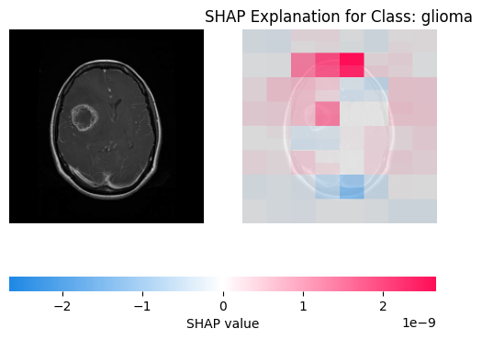
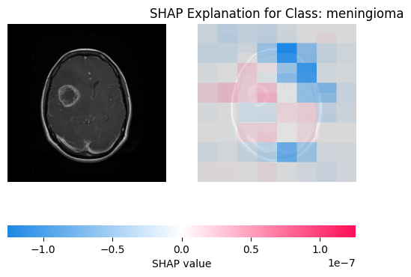
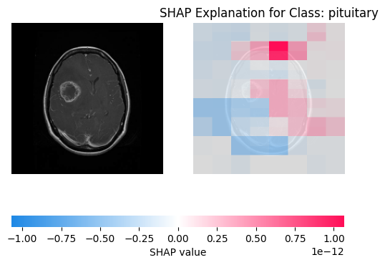
Glioma

Slide 8
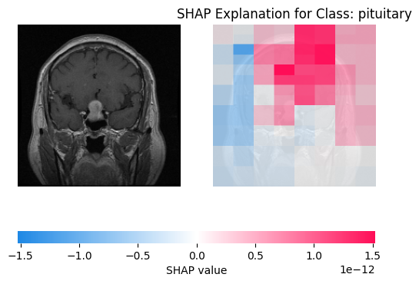
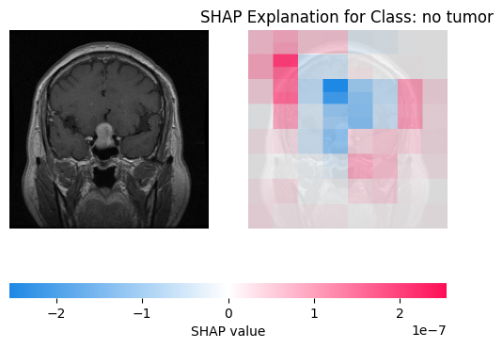
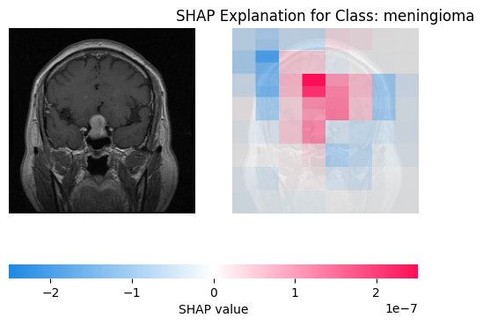
Pituitary

Slide 9
Transferability
Trying on a completely new dataset?
What did the model learn and can we generalize it on other types of cancer
Lungs.

Slide 10
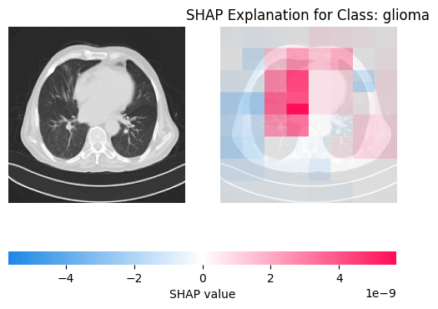
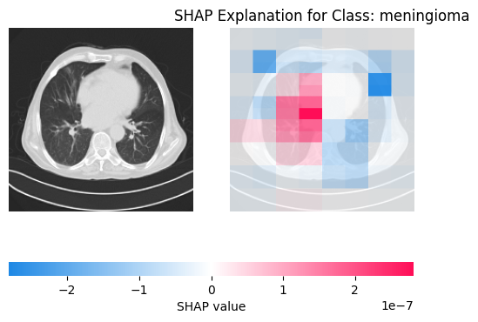
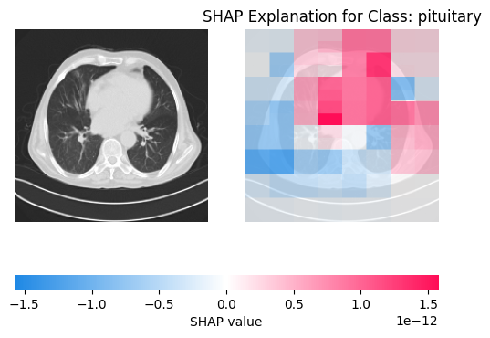
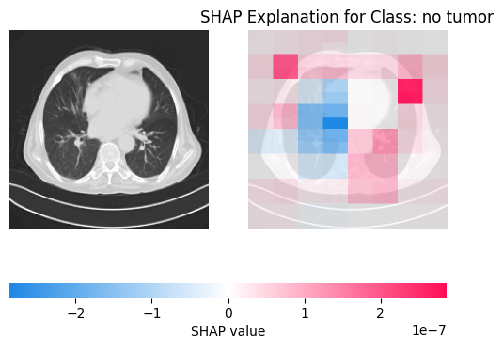
Lungs ( Malignant Case)

Slide 11
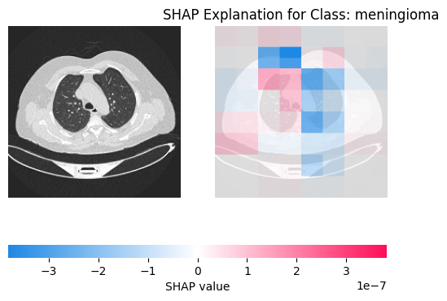
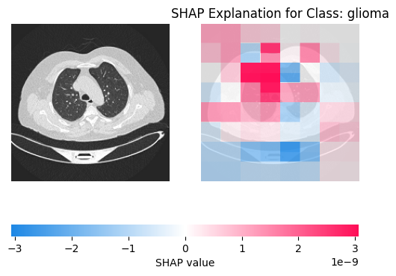
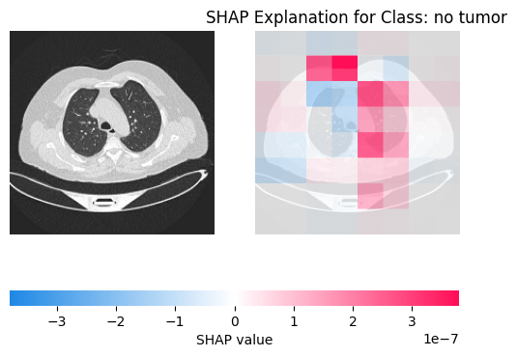
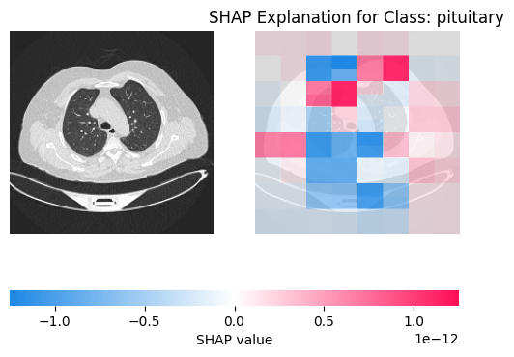
Benign Case

Slide 12
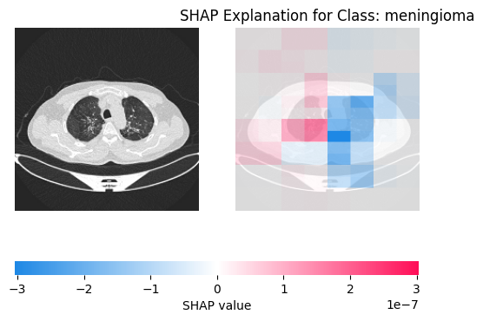
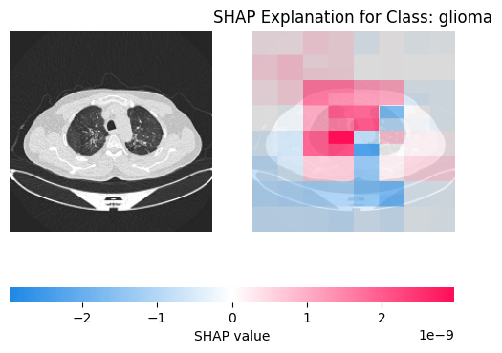
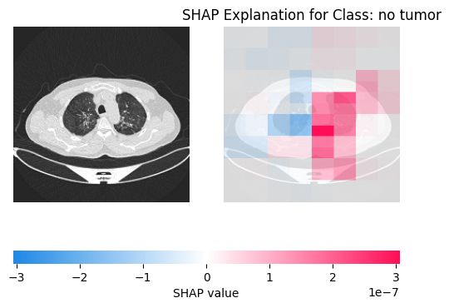
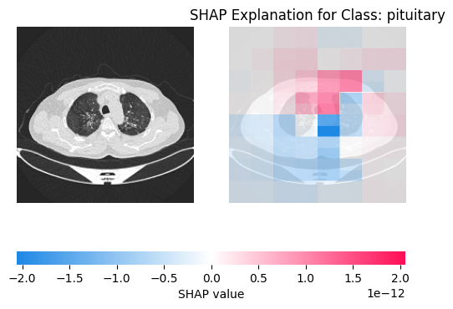
Normal Cancer Scan

Slide 13
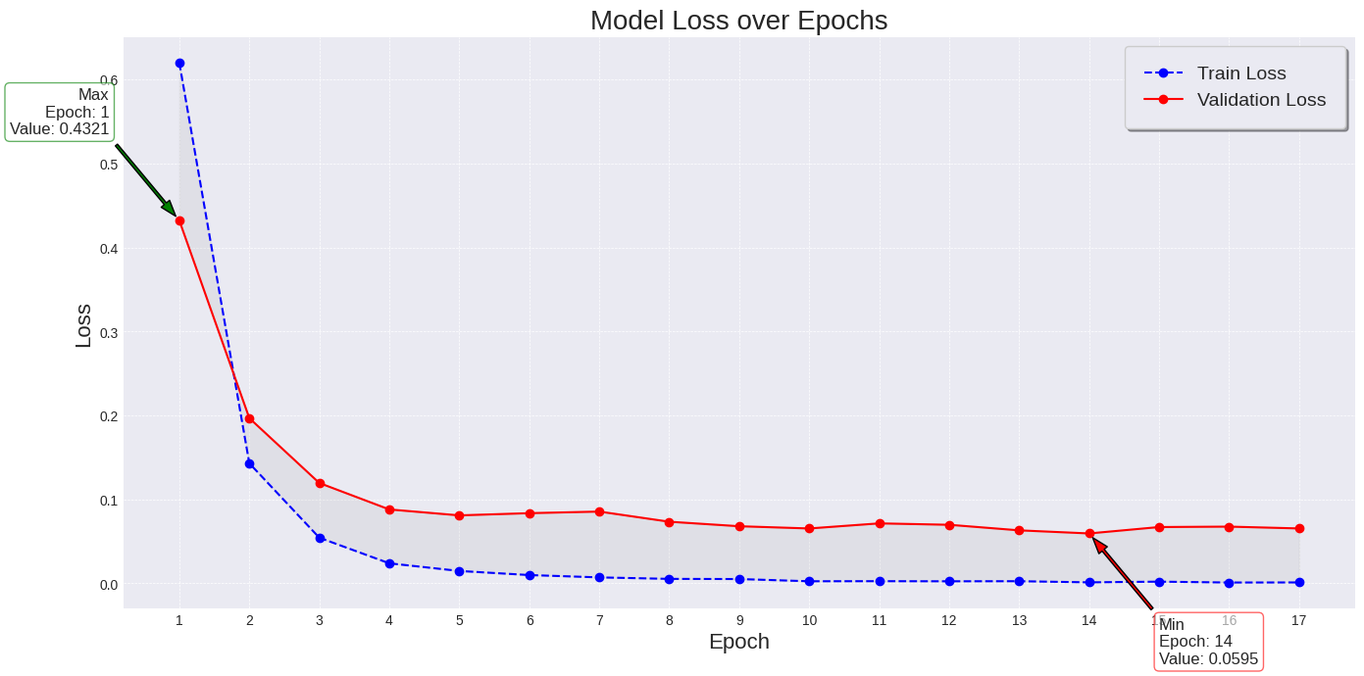

Slide 14
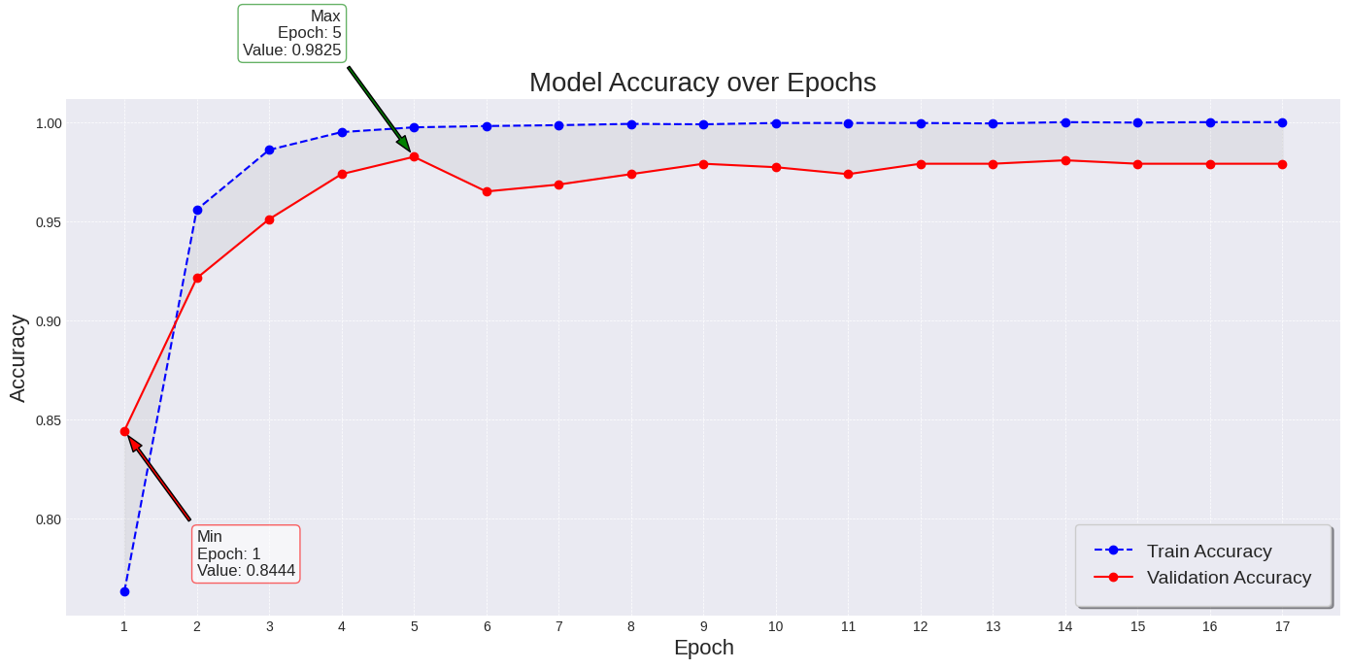

Slide 15
Limitations
We demonstrated our approach using available computational resources.
More extensive experiments with larger datasets, more ram, and better graphics processing units (GPU)
We demonstrated our approach using lung and brain cancer scans.
The results may vary with other types of scans (CT/X-Ray) or other types of medical images.

Slide 16
Limitations II
We demonstrated the use of SHAP for model interpretability
SHAP can be impacted by different parameters and builds, which may not always lead to an accurate representation of the models learning.

